Slide 1
Managing Multiple Windows with
OpenGL and GLUT
A mini-tutorial

Slide 2
Based upon:
The OpenGL Utility Toolkit (GLUT)
Programming Interface
API Version 3
Mark J. Kilgard
Copyright 1996

Slide 3
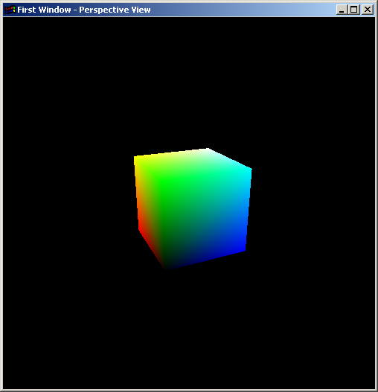
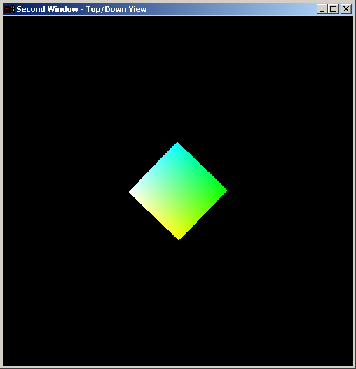
Two (or more) OpenGL/GLUT Windows
Window 1
Window 2
OpenGL
State
Callbacks
Frame
Buffer
Callbacks
OpenGL
State
Display Func.
Mouse Func.
Reshape Func.
Keyboard Func.
Etc.
Display Func.
Mouse Func.
Reshape Func.
Keyboard Func.
Etc.
Idle
Function
Shared

Slide 4
Steps for Creating Multiple Windows
Initialize drawing context and frame buffer using glutInit(), glutInitDisplayMode(), and glutInitWindowSize().
Create first window
Register callbacks for first window
Create second window
Position the second window
Register callbacks for second window
Register (shared) idle callback
Enter the main loop
Note: Callbacks can be shared between windows, if desired

Slide 5
Creating a Window
int glutCreateWindow(char *name);
Unique identifier of
the window created
Name of the window
Appears at top in window
decoration
Creates a window data structure and returns a small
integer identifier.
Window is not displayed until the main loop is entered
Window becomes the current window. The current window
Can be set or obtained using glutSetWindow() and
glutGetWindow().

Slide 6
Behavior of Callback Functions
Keyboard and mouse events are routed by the event loop to the callbacks registered for the current active window.
Display events are generated for each window separately when the O/S determines that the window must be redisplayed.
Display events can be user generated using glutPostRedisplay(). These events are routed to the display callback for the current window.
The shared idle() function is executed whenever no events are present in the event queue.

Slide 7
Example Using Two Windows
glutInitDisplayMode(GLUT_DOUBLE | GLUT_RGB |GLUT_DEPTH);
glutInitWindowSize(500, 500);
// create the first window
window1 = glutCreateWindow("First Window - Perspective View");
// register callbacks for first window, which is now current
glutReshapeFunc(window1_reshape);
glutDisplayFunc(window1_display);
glutMouseFunc(window1_mouse);
//create the second window
window2 = glutCreateWindow("Second Window - Top/Down View");
//define a window position for second window
glutPositionWindow(520,20);
// register callbacks for second window, which is now current
glutReshapeFunc(window2_reshape);
glutDisplayFunc(window2_display);
glutMouseFunc(window1_mouse); //note we share the mouse function
glutIdleFunc(spinCube); //idle function is not associated with a window
glutMainLoop();

Slide 8
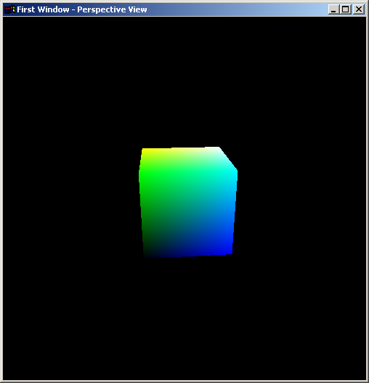
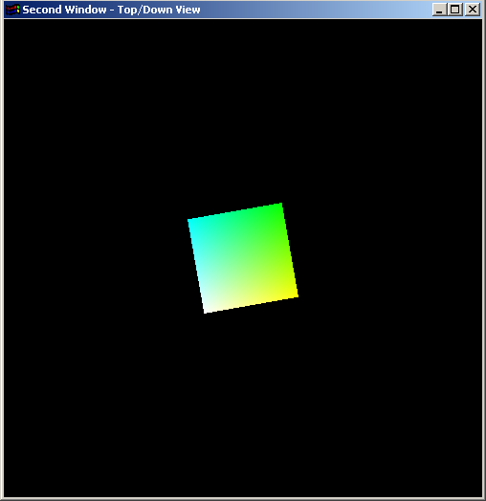
Resulting Display from Two Windows Code

Slide 9
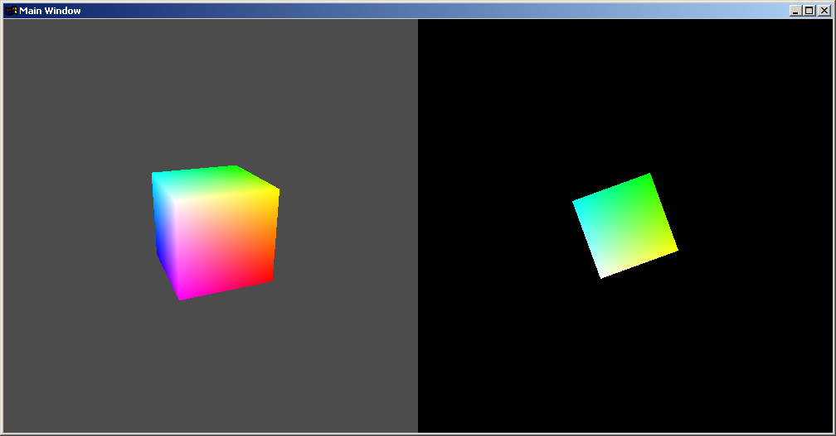
Generating Subwindows
Main Window
Subwindow1
Subwindow2

Slide 10
Subwindows
Are equivalent to any other window except that their coordinates are defined in terms of a parent window
Therefore, have their own OpenGL state and callback functions
Are not automatically resized when their parent window is resized
Can be nested arbitrarily deeply

Slide 11
Creating a Subwindow
Parent window identifier
Location wrt parent window
int glutCreateSubWindow(int win, int x, int y,
int width, int height);
Unique identifier of
the window created
Initial size of subwindow
Creates a subwindow data structure and returns a small
integer identifier.
Subwindow is not displayed until the main loop is entered
Subwindow becomes the current window. The current window
Can be set or obtained using glutSetWindow() and
glutGetWindow().

